Slide 1
Microeconomics

Slide 2
Key Terms (SSEM1)
Microeconomics: the study of people and businesses within a single market.
This small focus—on only one particular market—is one way microeconomics (literally “small economics”) is different from macroeconomics (“large economics”).

Slide 3
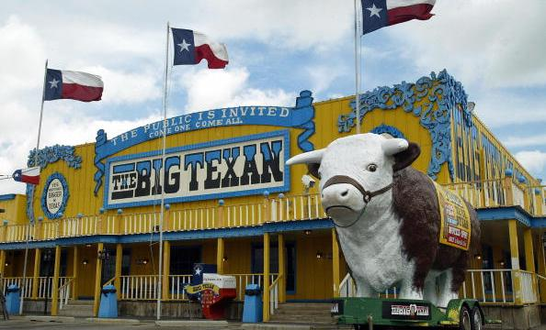
How does a steak make it to the Big Texan?

Slide 4
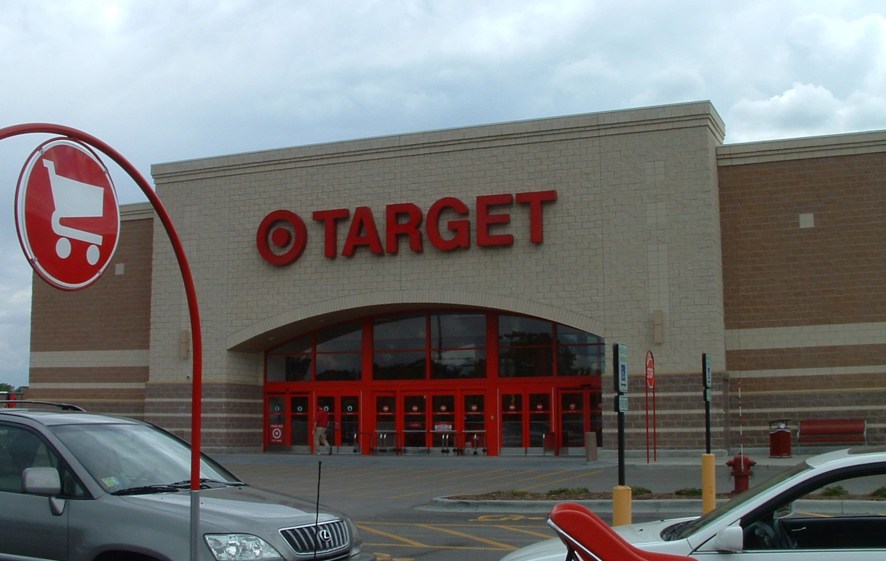
How does money go from a business to your hands?

Slide 5
Why do business and individual work together? (Think about the last two examples)

Slide 6
Circular Flow
Goods and services
Product Market
Role of Ind.:
Buy goods
Role of Busi.:
Sell goods
Goods
and Services
Spending
Revenue
$
$
Households (Individuals)
Business
Firms
Roles:
A. Resource
owners
(Mouse Click to Advance)
Role:
A. Producers B. Hire resource
(Mouse Click to advance)
(Mouse Click to advance)
(Mouse Click to advance)
(Mouse Click to advance)
(Mouse Click to advance)
(Mouse Click to advance)
(Mouse Click to advance)
Taxes &
Labor
Government
Taxes &
Goods
B. Consumers
Land, labor,
Capital
Factor Market
Role of Ind.:
Sell resource
Role of Busi.:
Buy resources
$income
$ Expense
Inputs for
production
© L Reynolds, 1999
Mouse click for next slide

Slide 7
Circular Flow
Goods and services
Product Market
Role of Ind.:
Buy goods
Role of Busi.:
Sell goods
Goods
and Services
Spending
Revenue
$
$
Households (Individuals)
Business
Firms
(Mouse Click to Advance)
Role:
A. Producers B. hire resource
(Mouse Click to advance)
(Mouse Click to advance)
(Mouse Click to advance)
(Mouse Click to advance)
(Mouse Click to advance)
(Mouse Click to advance)
Roles:
A. Resource
owners
(Mouse Click to advance)
Taxes &
Labor
Taxes &
Goods
Government
B. Consumers
Land, labor,
Capital
Factor Market
Role of Ind.:
Sell resource
Role of Busi.:
Buy resources
$income
$ Expense
Inputs for
production
© L Reynolds, 1999
Mouse click for next slide

Slide 8
The Circular Flow Diagram (SSEMI1a, b)
When buyers and sellers freely and willingly engage in market transactions, it is known in economics as voluntary exchange.
The transactions are made in such a way that both the buyer and seller benefit from the exchange. The circular flow diagram shows the interactions between buyers and sellers in different markets.
Economic Interdependence: reliance on one another to provide the goods and services that people consume

Slide 9
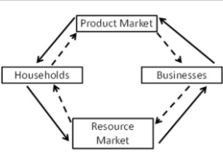
Role of Households in Circular Flow Diagram (SSEMI1a, b)
Households in the factor market (Resources) own productive resources.
They sell land, labor, and capital to businesses in the factor market in exchange for income.
Households in the product market (Stores) are the consumers of goods and services.
They use their income to buy goods and services from businesses.
Goods and Services represented by the Solid Arrows

Slide 10
Role of Businesses (firms) in Circular Flow Diagram (SSEMI1a, b)
Businesses (firms) in the factor market consume productive resources (land, labor, capital, and entrepreneurship).
Businesses (firms) in the product market produce the goods and services purchased by households.
The money received by businesses from households is revenue.
Money represented by the Dash Arrows)

Slide 11
Review Questions
Define microeconomics(BL)
Define macroeconomics (BL)
Define and give example of a product market(BL/PL)
Define and give example of a factor or resource market (BL/PL)
Define Economic Interdependence (BL)
Define the circular flow of goods and services(BL)

Slide 12
If you owned a Vans Corp., would you make more or less shoes as the price of the product goes UP? What if the price of the product goes DOWN?

Slide 13
Law of Supply and Demand (SSEMI2a)
Law of supply: an economic principle stating that as price rises, the quantity a seller is willing and able to sell increases.

Slide 14
What would you (personally) do if the price of Vans shoes went up in value? Would you buy more or less Vans shoes?

Slide 15
Law of Supply and Demand (SSEMI2a)
Prices are rarely stable over a long period of time.
Many factors can affect the supply or demand curves within a market. Here are some of the factors that can affect the price and quantity of a good.

Slide 16
Law of Supply and Demand (SSEMI2a)
Law of demand: an economic principle stating that as the price of a good rises, the quantity of the good consumers are willing and able to buy decreases.

Slide 17
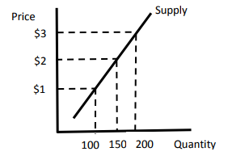
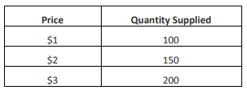
Quantity Supplied (SSEMI2b)
The quantity supplied is the amount of a good, service, or resource sellers are willing and able to sell at one specific price.
In the graph below, the quantity supplied at a price of $1 is 100 units of the good.
The market supply includes the quantities supplied at $1, $2, $3, and all other prices found along the curve.
The table in the example below is the Supply Schedule and provides the data you use to create a supply curve.

Slide 18
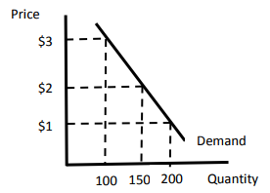
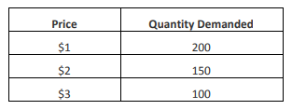
Quantity Demanded (SSEMI2)
The quantity demanded is the amount of a good, service, or resource buyers are willing and able to buy at one specific price.
In the graph below, the quantity demanded at a price of $1 is 200 units of the good.
The market demand includes the quantities demanded at $1, $2, $3, and all other prices found along the curve.
The table in the example below is the Demand Schedule and provides the data you use to create a demand curve.

Slide 19
Did the buyer and seller agree to the equilibrium price?

Slide 20
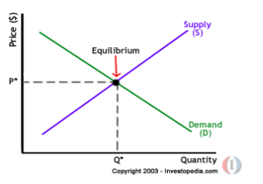
Equilibrium Price (SSEMI2c)
Equilibrium price or market clearing price is found at the intersection of the market demand and supply curves.
It is the point at which the quantity demanded by consumers is equal to the quantity supplied by producers.
Buyers will buy and sellers will sell

Slide 21
Review Questions
Define law of supply (BL)
Define law of demand (BL)
Draw and label supply on a graph (DL)
Draw and label demand on a graph (DL)
Draw and label the market-clearing price or equilibrium price graph (BL/PL)
When do buyers interact (purchase goods/services) in a market(DL)
When do sellers interact (sell goods/services) in a market (DL)

Slide 22
Supply Shifts (SSEMI2e)

Slide 23
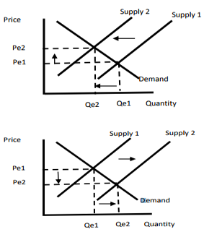
Reading the Supply Shift
The Top Graph Reads
Supply shifts to the left
Causing a
Decrease in Supply
Equilibrium Price Increases
Equilibrium Quantity Decreases

Slide 24
Reading the Supply Shift
The Bottom Graph Reads
Supply shifts to the right
Causing a
Increase in Supply
Equilibrium Price Decrease
Equilibrium Quantity Increases

Slide 25
WHY DOES SUPPLY CHANGE (SHIFT)
6 Determinants (SHIFTERS) of Supply
Change in the cost of productive resources
Change in government regulations (Taxes or Subsidies)
Change in the number of sellers
Change in producer expectations
Change in technology
Change in education

Slide 26
As Vans Corp., would you supply more or less shoes if the price of rubber when up?

Slide 27
Determinants (Shifters) of Supply (SSEMI2e)
Changes in . . .
Costs of productive resources—
If rubber (INPUT COST) goes up in price
What happens to (PICK GRAPH & READ)
Supply:
Equilibrium Price:
Equilibrium Quantity:
If rubber (INPUT COST) goes down in price
What happens to (PICK GRAPH & READ)
Supply:
Equilibrium Price:
Equilibrium Quantity:

Slide 28
As a Vans Corp., would you supply more or less shoes if the government increased your property taxes?

Slide 29
Determinants (Shifters) of Supply (SSEMI2e)
If Vans Property taxes goes up in price
What happens to (PICK GRAPH & READ)
Supply:
Equilibrium Price:
Equilibrium Quantity:
If Vans Property taxes goes down in price
What happens to (PICK GRAPH & READ)
Supply:
Equilibrium Price:
Equilibrium Quantity:

Slide 30
Determinants (Shifters) of Supply (SSEMI2e)
If shoe companies leave the market
What happens to (PICK GRAPH & READ)
Supply:
Equilibrium Price:
Equilibrium Quantity:
If shoe companies enter the market
What happens to (PICK GRAPH & READ)
Supply:
Equilibrium Price:
Equilibrium Quantity:

Slide 31
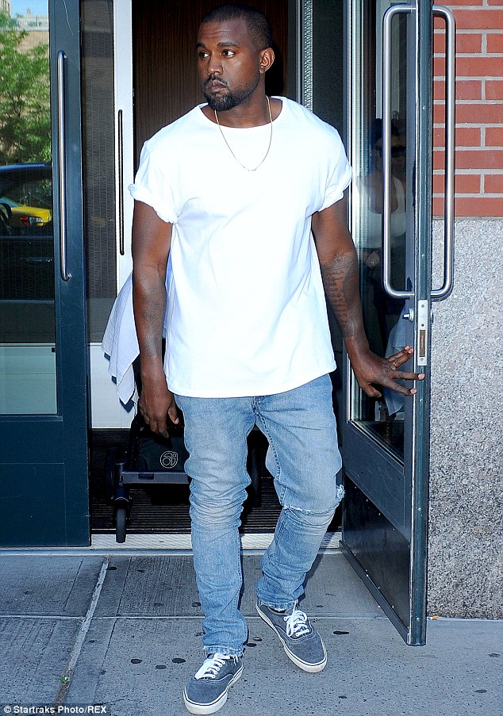
As a Vans Inc., would you supply more or less shoes if celebrities start wearing Vans?

Slide 32
Determinants (Shifters) of Supply (SSEMI2e)
Celebrities stop wearing Vans (Change in Expectations) What happens to (PICK GRAPH & READ)
Supply:
Equilibrium Price:
Equilibrium Quantity:
Celebrities start wearing Vans (Change in Expectations) What happens to (PICK GRAPH & READ)
Supply:
Equilibrium Price:
Equilibrium Quantity:

Slide 33
Determinants (Shifters) of Supply (SSEMI2e)
Vans shoe plant is destroyed in a fire (Change in Technology)
What happens to (PICK GRAPH & READ)
Supply:
Equilibrium Price:
Equilibrium Quantity:
Vans buys new machine to make shoes (Change in Technology)
What happens to (PICK GRAPH & READ)
Supply:
Equilibrium Price:
Equilibrium Quantity:

Slide 34
Determinants (Shifters) of Supply (SSEMI2e)
Less skilled workers want to work for Vans (Change in Education)
What happens to (PICK GRAPH & READ)
Supply:
Equilibrium Price:
Equilibrium Quantity:
Vans higher more skilled workers (Change in Education)
What happens to (PICK GRAPH & READ)
Supply:
Equilibrium Price:
Equilibrium Quantity:

Slide 35
Review Questions
Identify 6 determinants of or factors that cause a change in supply(BL)
__________________________________________________
__________________________________________________
__________________________________________________
__________________________________________________
__________________________________________________
__________________________________________________

Slide 36
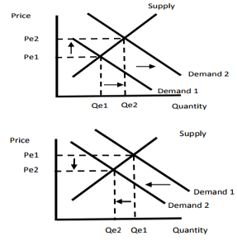
Demand Shifts (SSEMI2F)

Slide 37
Reading the Supply Shift
The Bottom Graph Reads
Demand shifts to the left
Causing a
Decrease in Demand
Equilibrium Price Increases
Equilibrium Quantity Decreases

Slide 38
Reading the Demand Shift
The T0p Graph Reads
Demand shifts to the right
Causing a
Increase in Demand
Equilibrium Price Decrease
Equilibrium Quantity Increases

Slide 39
WHY DOES Demand CHANGE (SHIFT)
6 Determinants (SHIFTERS) of Demand
Change in price of related goods
Complementary Goods
Substitute Goods
Changes in consumer income
Change in consumer expectations
Change in consumer tastes for a product
Change in number of consumers in the Market

Slide 40
What happens to your demand for Vans, if the price of Skateboards goes UP? (Are the products substitutes or complements)

Slide 41
Determinants (Demand) of Demand (SSEMI2e)
What happens to demand for Vans if the price of skateboards goes up.(Related Goods, Complementary)
What happens to (PICK GRAPH & READ)
Demand:
Equilibrium Price:
Equilibrium Quantity:
What happens to demand for Vans, if price of skateboards goes down (Related Goods, Complementary)
What happens to (PICK GRAPH & READ)
Demand:
Equilibrium Price:
Equilibrium Quantity:

Slide 42
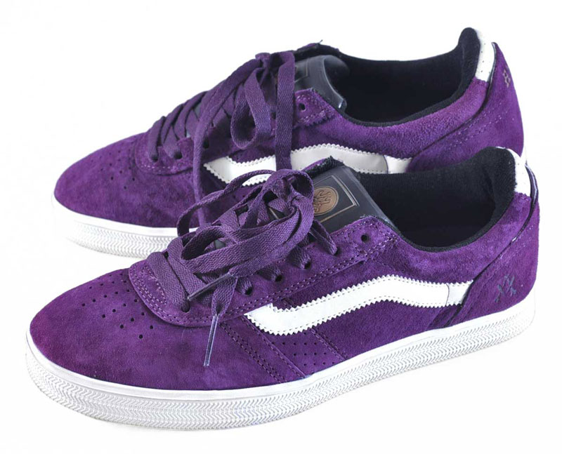
What happens to your demand for Vans, if the price of Jordan's goes UP? (Are the products substitutes or complements)

Slide 43
Determinants (Demand) of Demand (SSEMI2e)
What happens to demand for Vans if the price of Jordan’s goes down? (Related Goods, Substitute)
What happens to (PICK GRAPH & READ)
Demand:
Equilibrium Price:
Equilibrium Quantity:
What happens to the demand for Vans if the price of Jordan’s goes up? (Related Goods, Substitute)
What happens to (PICK GRAPH & READ)
Demand:
Equilibrium Price:
Equilibrium Quantity:

Slide 44
Determinants (Demand) of Demand (SSEMI2e)
What happens to your desire for Vans if you become a millionaire?(Change in Income)
What happens to (PICK GRAPH & READ)
Demand:
Equilibrium Price:
Equilibrium Quantity:
What happens to your desire for Vans if you lose your millions? (Change in Income)
What happens to (PICK GRAPH & READ)
Demand:
Equilibrium Price:
Equilibrium Quantity:

Slide 45
Determinants (Demand) of Demand (SSEMI2e)
What happens to your current demand for Vans if you know the Tax Free Shopping Weeks is one month away (Change in Expectations)
What happens to (PICK GRAPH & READ)
Demand:
Equilibrium Price:
Equilibrium Quantity:
What to your current demand for Vans if you expect the price of Vans to go up next month (Change in Expectations)
What happens to (PICK GRAPH & READ)
Demand:
Equilibrium Price:
Equilibrium Quantity:

Slide 46
What happens to your demand for Vans, if Justin Bieber started wearing Vans?

Slide 47
Determinants (Demand) of Demand (SSEMI2e)
What happens to your demand for Vans if your favorite Celebrity wears Vans(Change in Taste)
What happens to (PICK GRAPH & READ)
Demand:
Equilibrium Price:
Equilibrium Quantity:
What happens to your demand for Vans if your favorite Celebrity stops wearing Vans (Change in Taste)
What happens to (PICK GRAPH & READ)
Demand:
Equilibrium Price:
Equilibrium Quantity:

Slide 48
Determinants (Demand) of Demand (SSEMI2e)
What happens to demand when 1 million skateboarding immigrants enter the country. (Change in Number of Consumers)
What happens to (PICK GRAPH & READ)
Demand:
Equilibrium Price:
Equilibrium Quantity:
What happens to demand when 1 million Skateboarding immigrants are deported (Change in Number of Consumers)
What happens to (PICK GRAPH & READ)
Demand:
Equilibrium Price:
Equilibrium Quantity:

Slide 49
Review Questions
Identify 5 determinants or factors that cause a change in demand (BL)
__________________________________________________
__________________________________________________
__________________________________________________
__________________________________________________
__________________________________________________
__________________________________________________
Define and give an example of a Complementary good (BL/DL)
Define and give an example of a Substitute good (BL/DL)

Slide 50
Based on the chart are Minimum Wage jobs good or bad? Will this create a shortage or surplus of Minimum Wage jobs?

Slide 51
Price Floors and Price Ceilings (SSEMI2g)
A government may set a price floor or price ceiling on a good or service.
A price floor sets a minimum price for which a product can be sold.
Price floors often lead to a surplus of a good.
An example of a price floor is a minimum wage.

Slide 52
How could the government help workers live in the city?

Slide 53
Price Floors and Price Ceilings (SSEMI2g)
A price ceiling sets a maximum price at which a good can be sold.
A price ceiling often leads to a shortage.
An example of a price ceiling would be rent control.

Slide 54
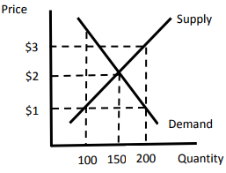
Reading Price Ceilings and Floors
Price Ceiling
At $1, is there a shortage or surplus
What is greater quantity supplied or quantity demanded?
What is the measure of shortage or surplus? (LOOK AT QUANTITY)
Price Floor
At $3, is there a shortage or surplus
What is greater quantity supplied or quantity demanded?
What is the measure of shortage or surplus (LOOK AT QUANTITY)

Slide 55
Review Questions
Define and give example of price ceiling (BL/DL)
Define and give example of price floor (BL/DL)
What do price ceilings create? (SHORTAGE OR SUPLUS) (DL)
What do price floors create? (SHORTAGE OR SUPLUS) (DL)
Draw a graph with a price floor and a price ceiling, show shortage and surplus? (PL)

Slide 56
Types of Business Organizations (SSEMI3a)
Sole proprietorship: A sole proprietorship has a single owner.
Partnership: A partnership divides up the risk and reward among a group of people.
Corporations: Corporations issue stock, and anyone who owns stock in the corporation owns a portion of that corporation.

Slide 57
What are the positives and negatives of owning your own business?

Slide 58
Sole Proprietorship (SSEMI3a)
Advantages
Easy to start
All decision making power belongs to the owner
Profits are taxed once
Disadvantages
The owner is personally and fully responsible for all losses and debts of the business
Limited ability to raise funds for the business
Limited life: usually ends with death or retirement of owner

Slide 59
What are the positives and negatives of owning a partnership business?

Slide 60
Partnership (SSEMI3a)
Advantages
Benefit of specialization
Profit taxed only once
Disadvantages
Partners face unlimited liability
Decision making can be complex (limited life)
Owners share profits and costs

Slide 61
What are the positives and negatives of a corporation?

Slide 62
Corporation (SSEMI3a)
Advantages
Share holders are not personally responsible for all losses and debts of the business.
Business has a long life span
Usually able to raise large sums of money
Disadvantages
Double Taxation: the profits that the company makes are taxed twice
Corporations are complicated to set up

Slide 63
Review Questions
What are some characteristics of a Sole Proprietorship?
What are some characteristics of a Partnership?
What are some characteristics of a Corporations

Slide 64
Four Types of Market Structures (SSEMI3b)
HINT: ALWAYS USE EXAMPLES TO REMEMBER TYPES AND CHARACTERISTICS OF MARKET STUCTURES

Slide 65
Four Types of Market Structures (SSEMI3b)
Monopoly: a market structure in which a commodity is supplied by one firm.
Example: Georgia Power, Natural Gas Providers

Slide 66
Characteristics of a Monopoly (SSEMI3b)
Number of firms: one
Barriers to enter the market: all most impossible
Control over price: complete
Type of product: unique, no substitute
Advertisement: none
Example: Georgia Power and diamond company DeBeers

Slide 68
Four Types of Market Structures (SSEMI3b)
Oligopoly: a market structure of imperfect competition in which an industry is dominated by a small number of suppliers.
Examples: Craft, Coca Cola, Pesico

Slide 69
Characteristics of an Oligopoly (SSEMI3b)
Number of firms: few (three or four)
Barriers to enter the market: difficult
Control over price: some
Type of product: some differences
Advertisement: much
Example: Kraft, Coca Cola, Pesico, Ford, Chevy

Slide 70
Four Types of Market Structures (SSEMI3b)
Monopolistic competition: a market structure in which there are a large number of sellers who are supplying goods that are close, but not perfect, substitutes. Sellers have a degree of control over price. There are few long-term barriers of entry and exit.
Example: Shoe companies

Slide 71
Characteristics of a Monopolistic Competition (SSEMI3b)
Number of firms: many
Barriers to enter the market: fairly easy
Control over price: little
Type of product: similar but different
Advertisement: much
Example: Shoe companies, Jean companies

Slide 72
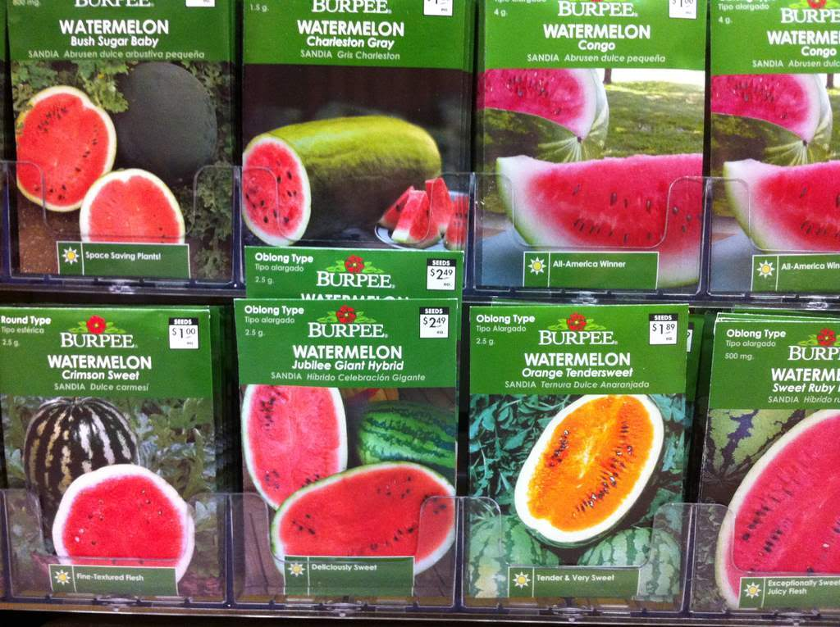
Four Types of Market Structures (SSEMI3b)
Pure (perfect) competition: a market structure in which there are a large number of sellers who are supplying goods but not a large enough number to set the price of the goods. There are no barriers of entry and exit.
Examples: Watermelons and Tomato Farmers

Slide 73
Characteristics of a Perfect Competition (SSEMI3b)
Number of firms: many
Barriers to enter the market: none
Control over price: none
Type of product: similar or identical
Advertisement: none
Example: Watermelon and Tomato Farmers

Slide 74
Review Questions
What is an example of a Monopoly?
What are some characteristics of a Monopoly?
What is an example of a Oligopoly?
What are some characteristics of a Oligopoly?
What is an example of a Monopolistic Competition?
What are some characteristics of a Monopolistic Competition?
What is an example of a Pure (Perfect) Competition?
What are some characteristics of a (Perfect) Competition?

