Slide 1
Inflation Station 5 stations/5 topics
Topics:
Definition of Inflation (And connecting it to the business cycle)
Purchasing Power
CPI/Market Basket of Goods
AS/AD and it’s effect on Price Level
Those Hurt and Helped by Unexpected Inflation

Slide 2
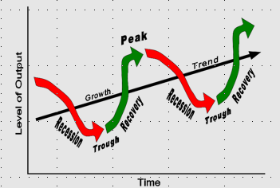
Answer: 1. Based on the Image to the left, What is Inflation? 2. Draw a labeled business cycle. Place the following events on the business cycle where they belong: 1. Inflation Increases 2. Inflation Decreases (Deflation) 3. GDP Increases 4. GDP Decreases 5. Unemployment Increases 6. Unemployment Decreases

Slide 3
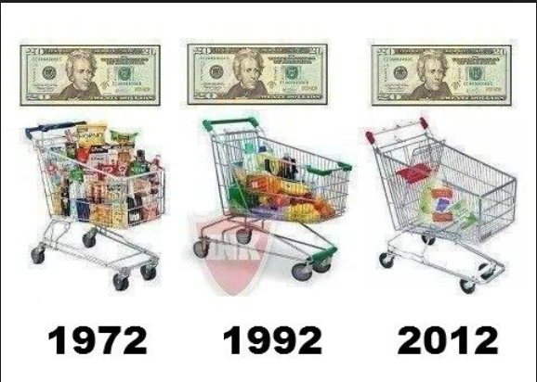
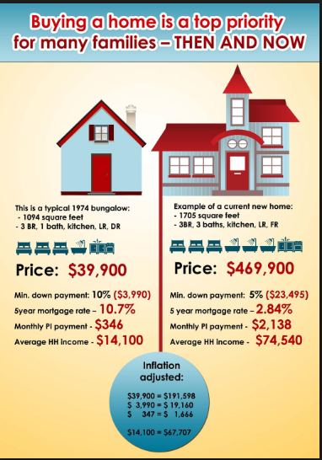
PURCHASING POWER
Based on the images, answer the following questions IN COMPLETE SENTENCES:
1. What do you think the definition of “purchasing power” is?
2. What do these images tell you about purchasing power? (How much you can get for your money?)
3. Why do you think purchasing power has changed so much throughout the years? What has changed?
4. How do these images represent the definition of inflation?

Slide 4
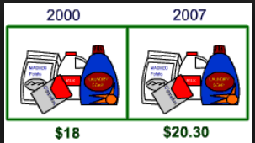
CPI AND THE MARKET BASKET OF GOODS
Define: Consumer Price Index Consumer Price Index (CPI): the average price of a market basket of goods used to measure inflation. Answer: 1. Based on the Chart and Definition of CPI: How could we (do we?) measure inflation using the CPI? 2. What are the 8 components (parts) of the market basket of goods?
Why do you think those 8 parts are included?
Look at the percentages attached to each part of the market basket. What do people spend the most of their money on? Are any of the percentages surprising to you? Explain.
If you had to divide up the types of goods/services you purchase into 8 categories, what would they be? How is that similar or different to the Consumer Price Index Components you see to the left?

Slide 5
AGGREGATE SUPPLY AND AGGREGATE DEMAND: macroeconomic ideas that parallel supply and demand in microeconomics. ***Total demand for goods and services within a nation combines to form aggregate demand, while the total supply of goods and services within a country is its aggregate supply.** Answer: 1. What do you think the word “AGGREGATE” means given the above definitions? Using the Aggregate Demand and Aggregate Supply Graph to the left, Answer the following questions: 1. What would happen to Price Level and Real GDP if Aggregate demand Increased? 2. What would happen to Price Level and Real GDP if Aggregate Demand Decreased? 3. What would happen to Price level and Real GDP if Aggregate Supply Increased? 4. What would happen to Price level and Real GDP if Aggregate Supply Decreased?
Real GDP

Slide 6
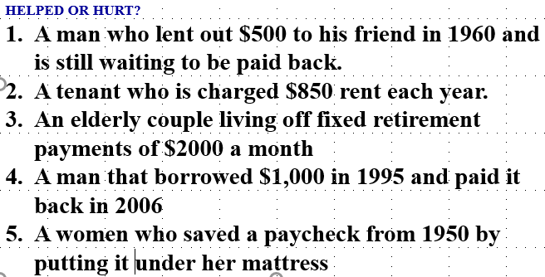
WINNERS AND LOSERS OF INFLATION 1. CREATE A T-CHART WITH THIS INFORMATION 2. For the 5 Scenarios—Decide who is Helped or Hurt by Unexpected Inflation
Those Hurt by Inflation
Those Helped by Inflation
Lenders: People who lend money (at a fixed interest rate)
People with fixed incomes (incomes that DO NOT change)
People who save money (their money is worth LESS)
Borrowers—People who borrow money (the value of the money they borrowed has gone down)
A business where the price of the product increases faster than the price of resources

