Slide 1
Economics International Finance review
Unit 6

Slide 2
Explain which person has the absolute advantage and comparative advantage in each task
How do we know they had a comparative advantage?

Slide 3
Explain each of the following and give an example
Tariffs
Quotas
Embargoes
Standards
Subsidies
What are the cost and benefits of trade barriers over time?

Slide 4
What is a trading block and give me three examples.
What are some arguments for and against free trade?

Slide 5
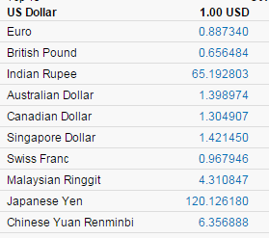
Exchange Rates
What are exchange rates?
Covert the following
$3 → Australian Dollars
4374 Ringgit → US Dollars
What is appreciation and
depreciation?

Slide 6
Economics Monetary and fiscal policy review
Unit 5

Slide 7
Define
What is monetary policy?
What is fiscal policy?
What is the FED?
What does it mean to “heat up” our economy?
What does it mean to “cool down” our economy?

Slide 8
Monetary Policy
List the ways the FED can heat up our economy?
List the ways the FED can cool down our economy?

Slide 9
Fiscal Policy
List the ways the government can heat up our economy?
List the ways the government can cool down our economy?

Slide 10
Taxes
Define and give me an example of each of the following types of taxes:
Progressive Tax
Regressive Tax
Proportional Tax

Slide 11
What happens…
What happens to inflation when we…
Heat up our economy
Cool down our economy
What happens to unemployment when we…
Heat up our economy
Cool down our economy

Slide 12
Money
What are the three uses of money?
What are the five characteristics of money?
What are the three sources of money?
What are the three forms of money?
How do we measure money?

