Slide 1
Economics final microeconomics review
Unit 2

Slide 2
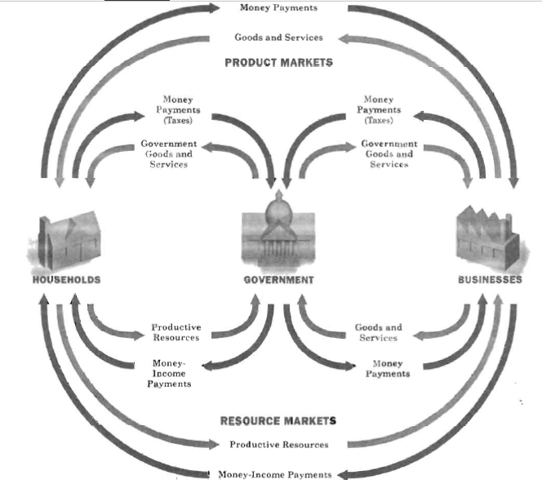
Label the circular flow diagram

Slide 3
Money
Explain how it is used as a medium of exchange

Slide 4
supply
What is the law of supply?
Graph supply
How does price affect supply?
Show a decrease in supply and an increase in supply on a graph
What are some factors that might increase or decrease supply?

Slide 5
The price of aluminum decreases for the Coke company

Slide 6
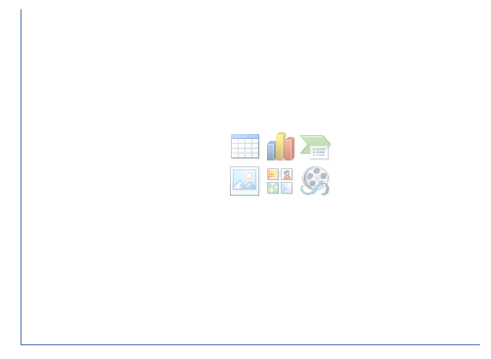
Chick-fil-a Opens two new stores in cobb county

Slide 7
Demand
What is the law of demand?
Graph demand
How does price affect demand?
Show a decrease in demand and an increase in demand on a graph
What are some factors that might increase or decrease demand?

Slide 8
Burger King makes a press statement that a shipment of their beef contained mad cow disease.

Slide 9
Over labor day weekend Kroger puts hot dogs on sale. What does this do to the market for buns?

Slide 10
Market equilibrium price
What is market equilibrium price?
How do we know what the market equilibrium price is on a graph?

Slide 11
Label the graph
F
Supply
Demand
Equilibrium Price
Price Ceiling
Price Flood
Surplus
Shortage
D
B
C
A
E
G

Slide 12
Elastic or Inelastic? WHY?
3D TV’s
Milk
Toyota Tundra
Cold and Flu medicine
Plane Tickets
Electricity

Slide 13
Give me some compliments
Cell Phones
Computers
Cars
Chicken
Hamburgers

Slide 14
Give me some competitors/alternatives
Cars
Pencils
Beef
Computers

