Slide 1
Economics Final Principals Review
Unit 1

Slide 2
Basic Problems
What is the #1 problem of economics?
Define scarcity

Slide 3
3 basic questions of economics
What are the three basic questions of economics?
How do we try and answer these questions?

Slide 4
Resources
What are the four types of resources used?
Give me an example of each of the four types of resources.

Slide 5
Opportunity Cost
What is opportunity cost?
For each scenario identify what is scarce as well as the opportunity cost:
I have $50 and decide between two DVDs or a video games. I decided to by the movies since they are two I really wanted to see.
I have 2 hours between school and football practice. I am hungry, but also have grading to do. I decided to sit at school and get the econ projects graded.

Slide 6
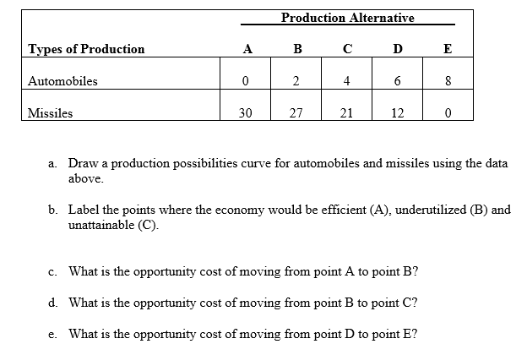
Graph the Production Possibilities Curve

Slide 7
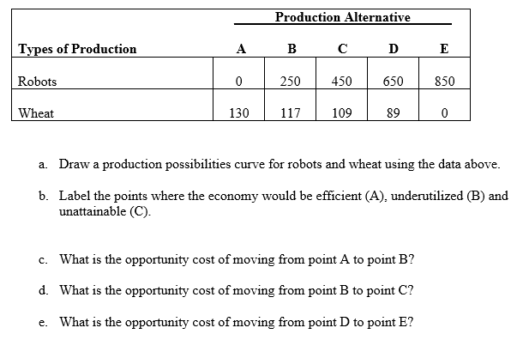
Graph the Production Possibilities Curve

Slide 8
Define
Rational
Marginal

Slide 9
You own a business that produces tires. You can purchase a pallet of rubber for $75. Each tire you can sell for $30 a piece to consumers. Complete the chart to figure out marginal cost and benefit and tell me when it becomes an irrational decision.

Slide 10
Define and answer
Specialization
Command Economy
Market Economy
Mixed Economy
Why does the government provide public goods and services?
How does the government regulate and deregulate consumers and producers?
Explain how technology leads to economic growth
How does education lead to a higher standard of living?

