Slide 1
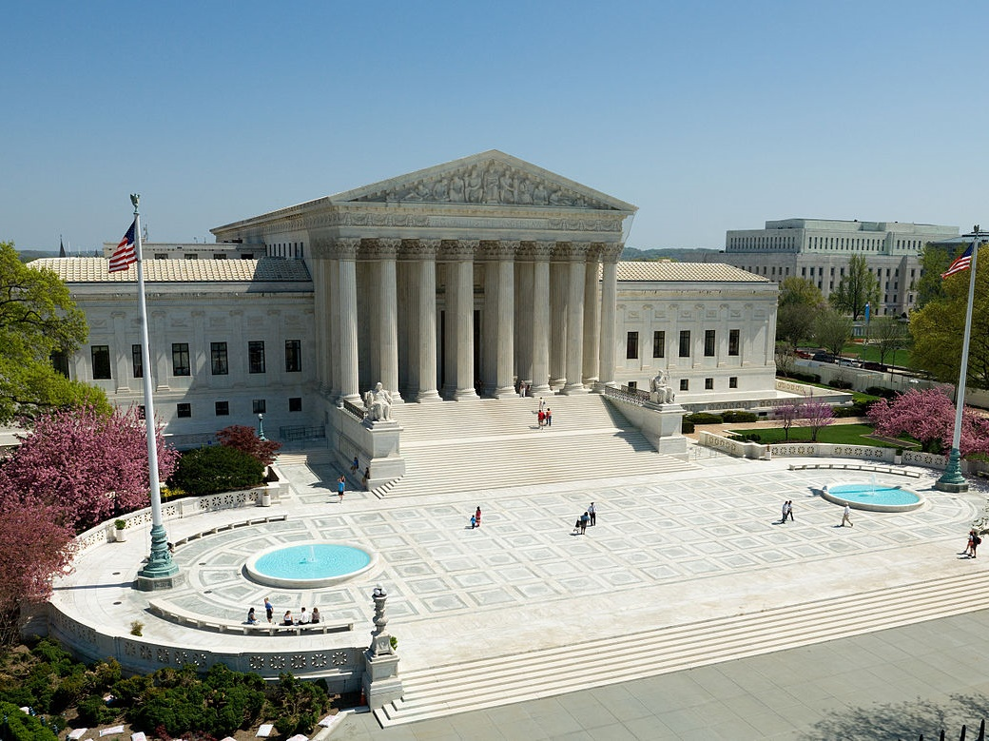
Notes:
* All images of the Supreme Court and protests from Wikimedia Images.

Slide 2
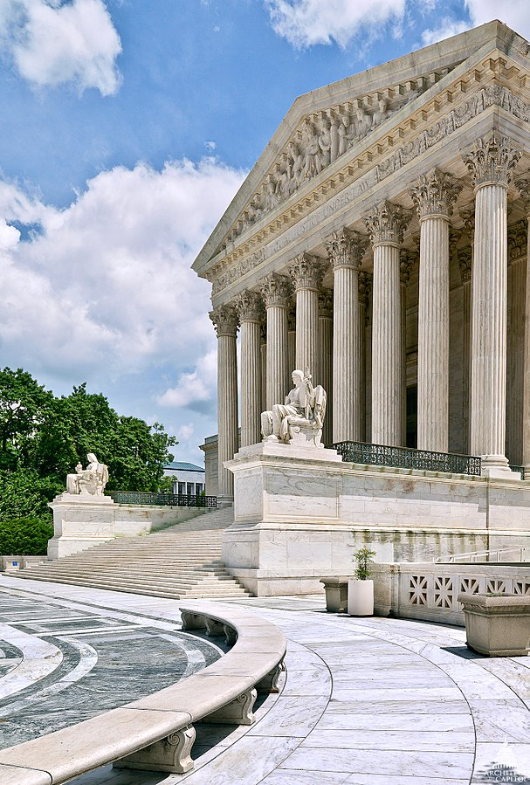
Judicial review: may decide the Constitutionality of an act of government
Marbury v. Madison (1803): Chief Justice John Marshall set up this precedent
Both original and “appellate” jurisdiction
That is, the power to review decisions and change outcomes of decisions of lower courts

Slide 3
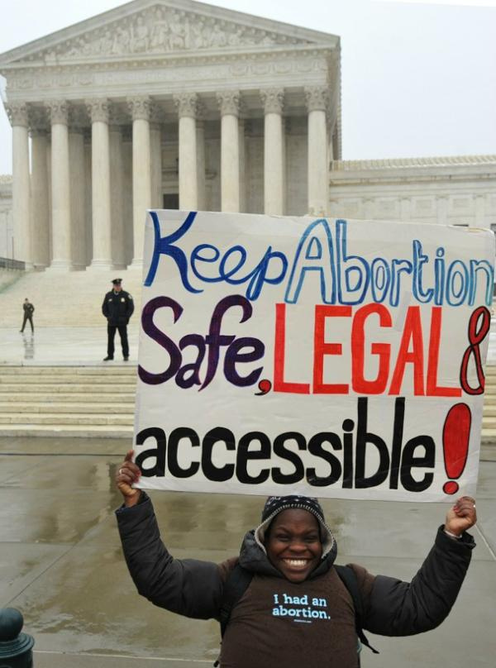
Courts make public policy by interpreting the Constitution
Marbury v. Madison: judicial review
Dred Scott v. Sanford: set stage for Civil War
Roe v. Wade: invalidated many state laws on abortion

Slide 4
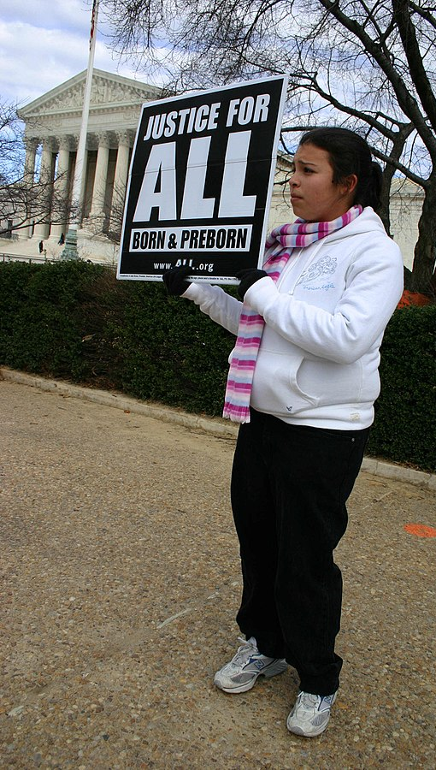
Original jurisdiction over cases involving two or more States and all cases brought against ambassadors or other public ministers.
Most cases heard by the Court are appeals cases.
The Court hears only one to two cases in which it has original jurisdiction per year.

Slide 5
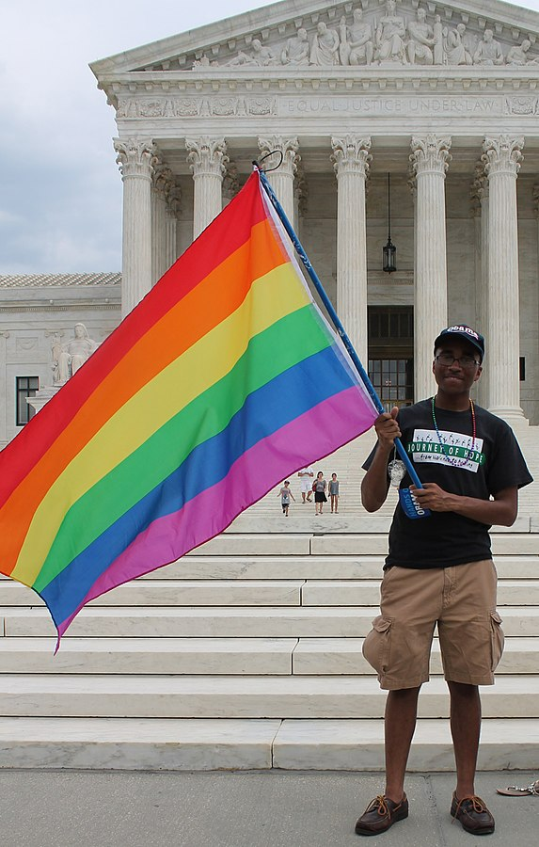
8,000 cases appealed to SC each year; only accepts a few hundred
“Rule of four”: at least 4/9 justices must agree to hear a case
If it does not accept a case, the ruling of the last court stands: “stare decisis”

Slide 6
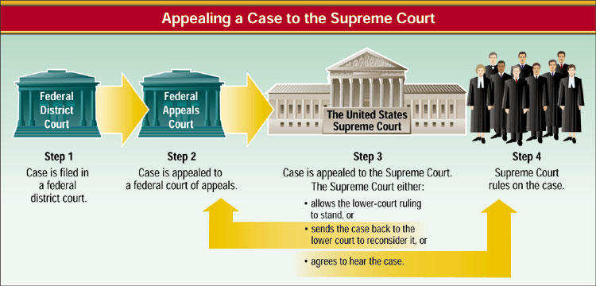

Slide 7
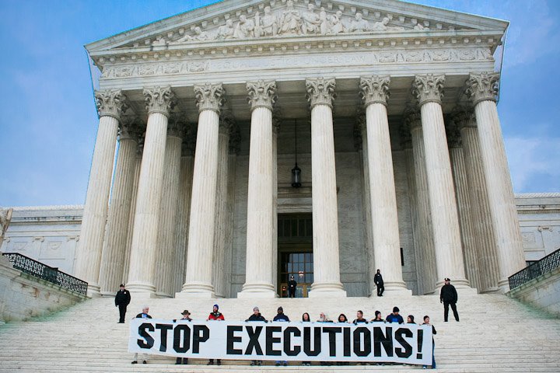
Writ of Certiorari
Most cases reach the Court via writ of certiorari: a request that the Supreme Court order a lower court to send up a case for review.
Certified Question
Cases can reach the Court by certificate when a lower court asks the Supreme Court for an opinion on a question of law.

Slide 8
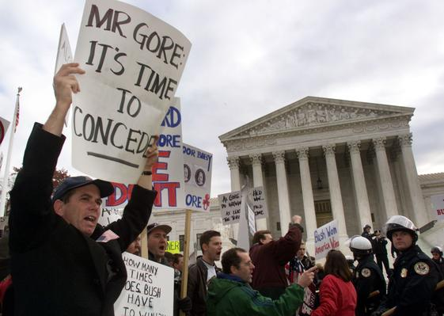
Oral Arguments
Once the Supreme Court accepts a case, it sets a date for when lawyers on both sides will present oral arguments.
Briefs
Written documents are filed with the Court before oral arguments begin.
The Court in Conference
The Chief Justice presides over a closed-door conference in which justices present their views on the case at hand.

Slide 9
Once the Court finishes its conference, it reaches a decision and an opinion is written

Slide 10
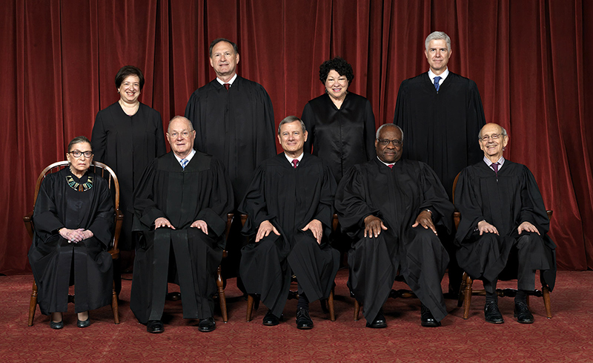
8 associate justices and 1 chief justice
Justices are appointed by the president & serve for life (or until they retire)
Every president who has served a full term (except Carter) has appointed at least 1 justice
Given that justices may serve for years after the president leaves office, their appointments serve to carry on political legacies

Slide 11
Name | Born | Appointed | President who Appointed
Anthony Kennedy | 1936 | 1988 | Reagan
Clarence Thomas, | 1948 | 1991 | Bush, G.H.W
Ruth Bader Ginsburg | 1933 | 1993 | Clinton
Stephen Breyer | 1938 | 1994 | Clinton
John Roberts* | 1955 | 2005 | Bush, G. W.
Samuel Alito | 1950 | 2006 | Bush, G. W.
Sonia Sotomayor | 1954 | 2009 | Obama
Elena Kagan | 1960 | 2010 | Obama
Neil Gorsuch | 1967 | 2017 | Trump
* Chief Justice of the Supreme Court

Slide 12
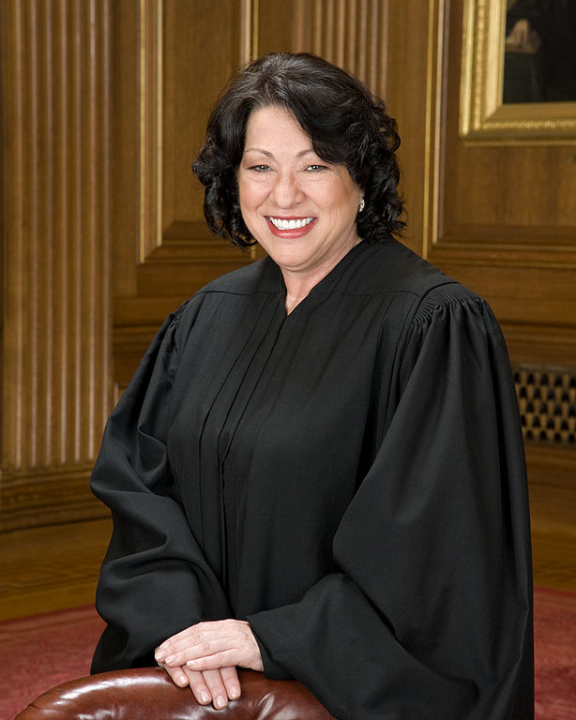
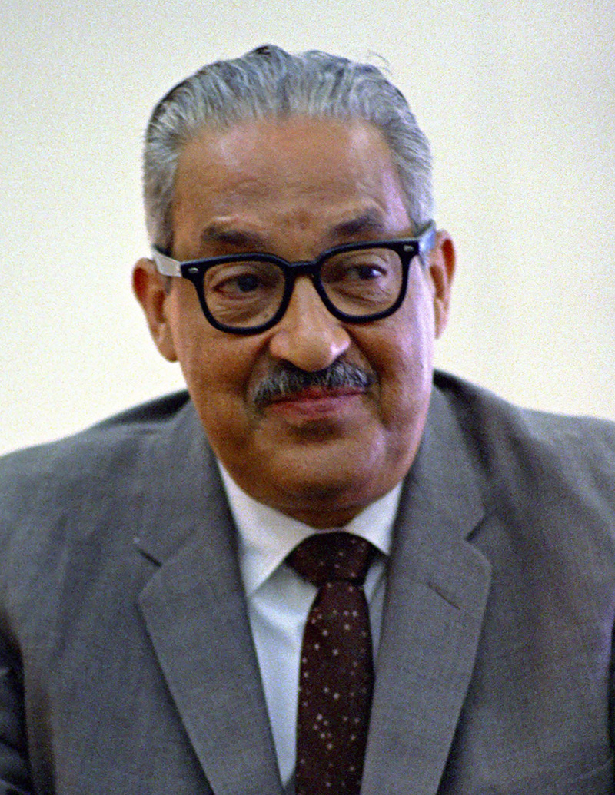
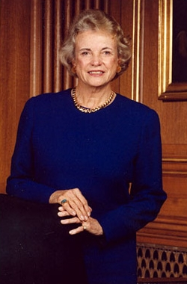
First African American Justice- Thurgood Marshall (appointed by Lyndon Johnson- 1967-93)
First Woman Justice- Sandra Day O’Connor (appointed by Ronald Reagan- served from 1981-2006)
First Hispanic Justice- Sonia Sotomayor (appointed by Barack Obama- 2009

Slide 13
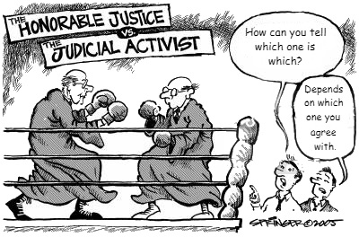
Judicial Activism - Judicial tendency to overturn previous decisions of the court, or ruling of laws as being unconstitutional
Judicial Restraint - Judicial tendency to let prior decisions stand

