Slide 1
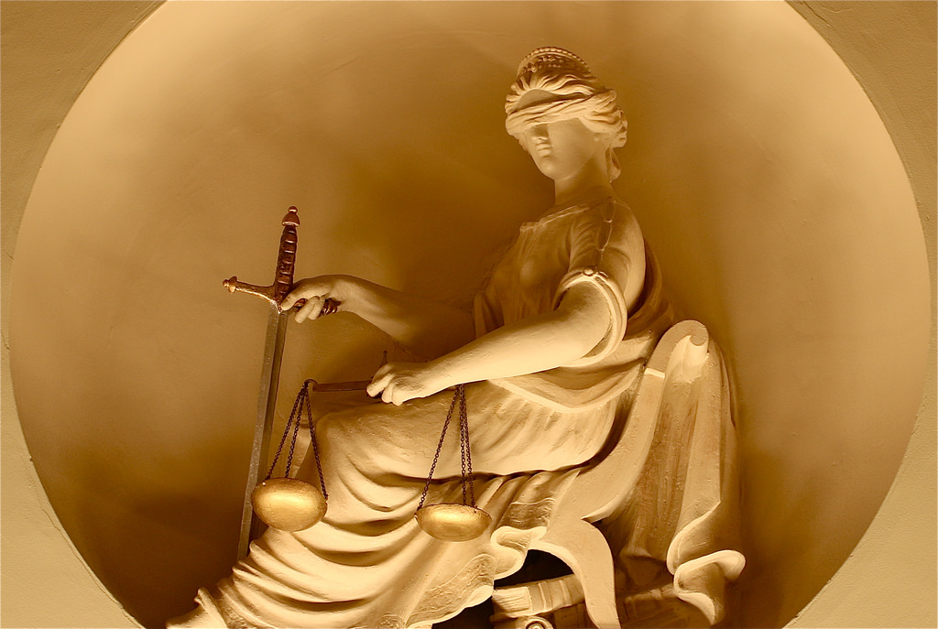

Slide 2
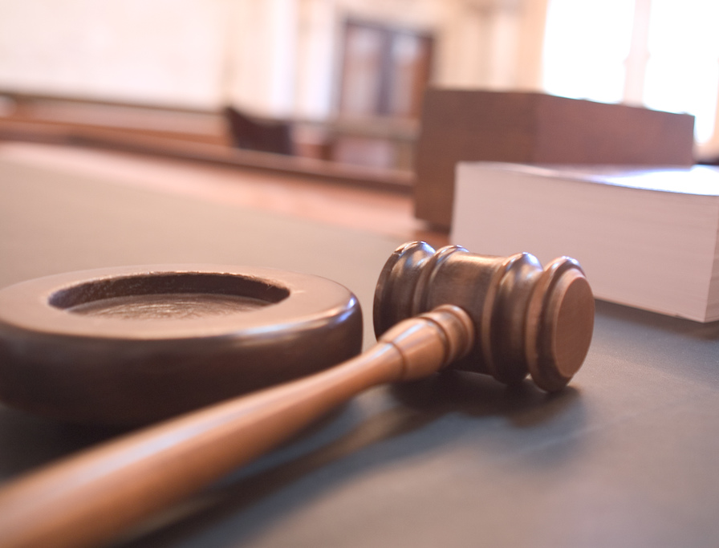
Differences Between Criminal and Civil
Criminal: you’ve committed a crime
Civil: You have somehow caused harm, or violated someone’s rights

Slide 3
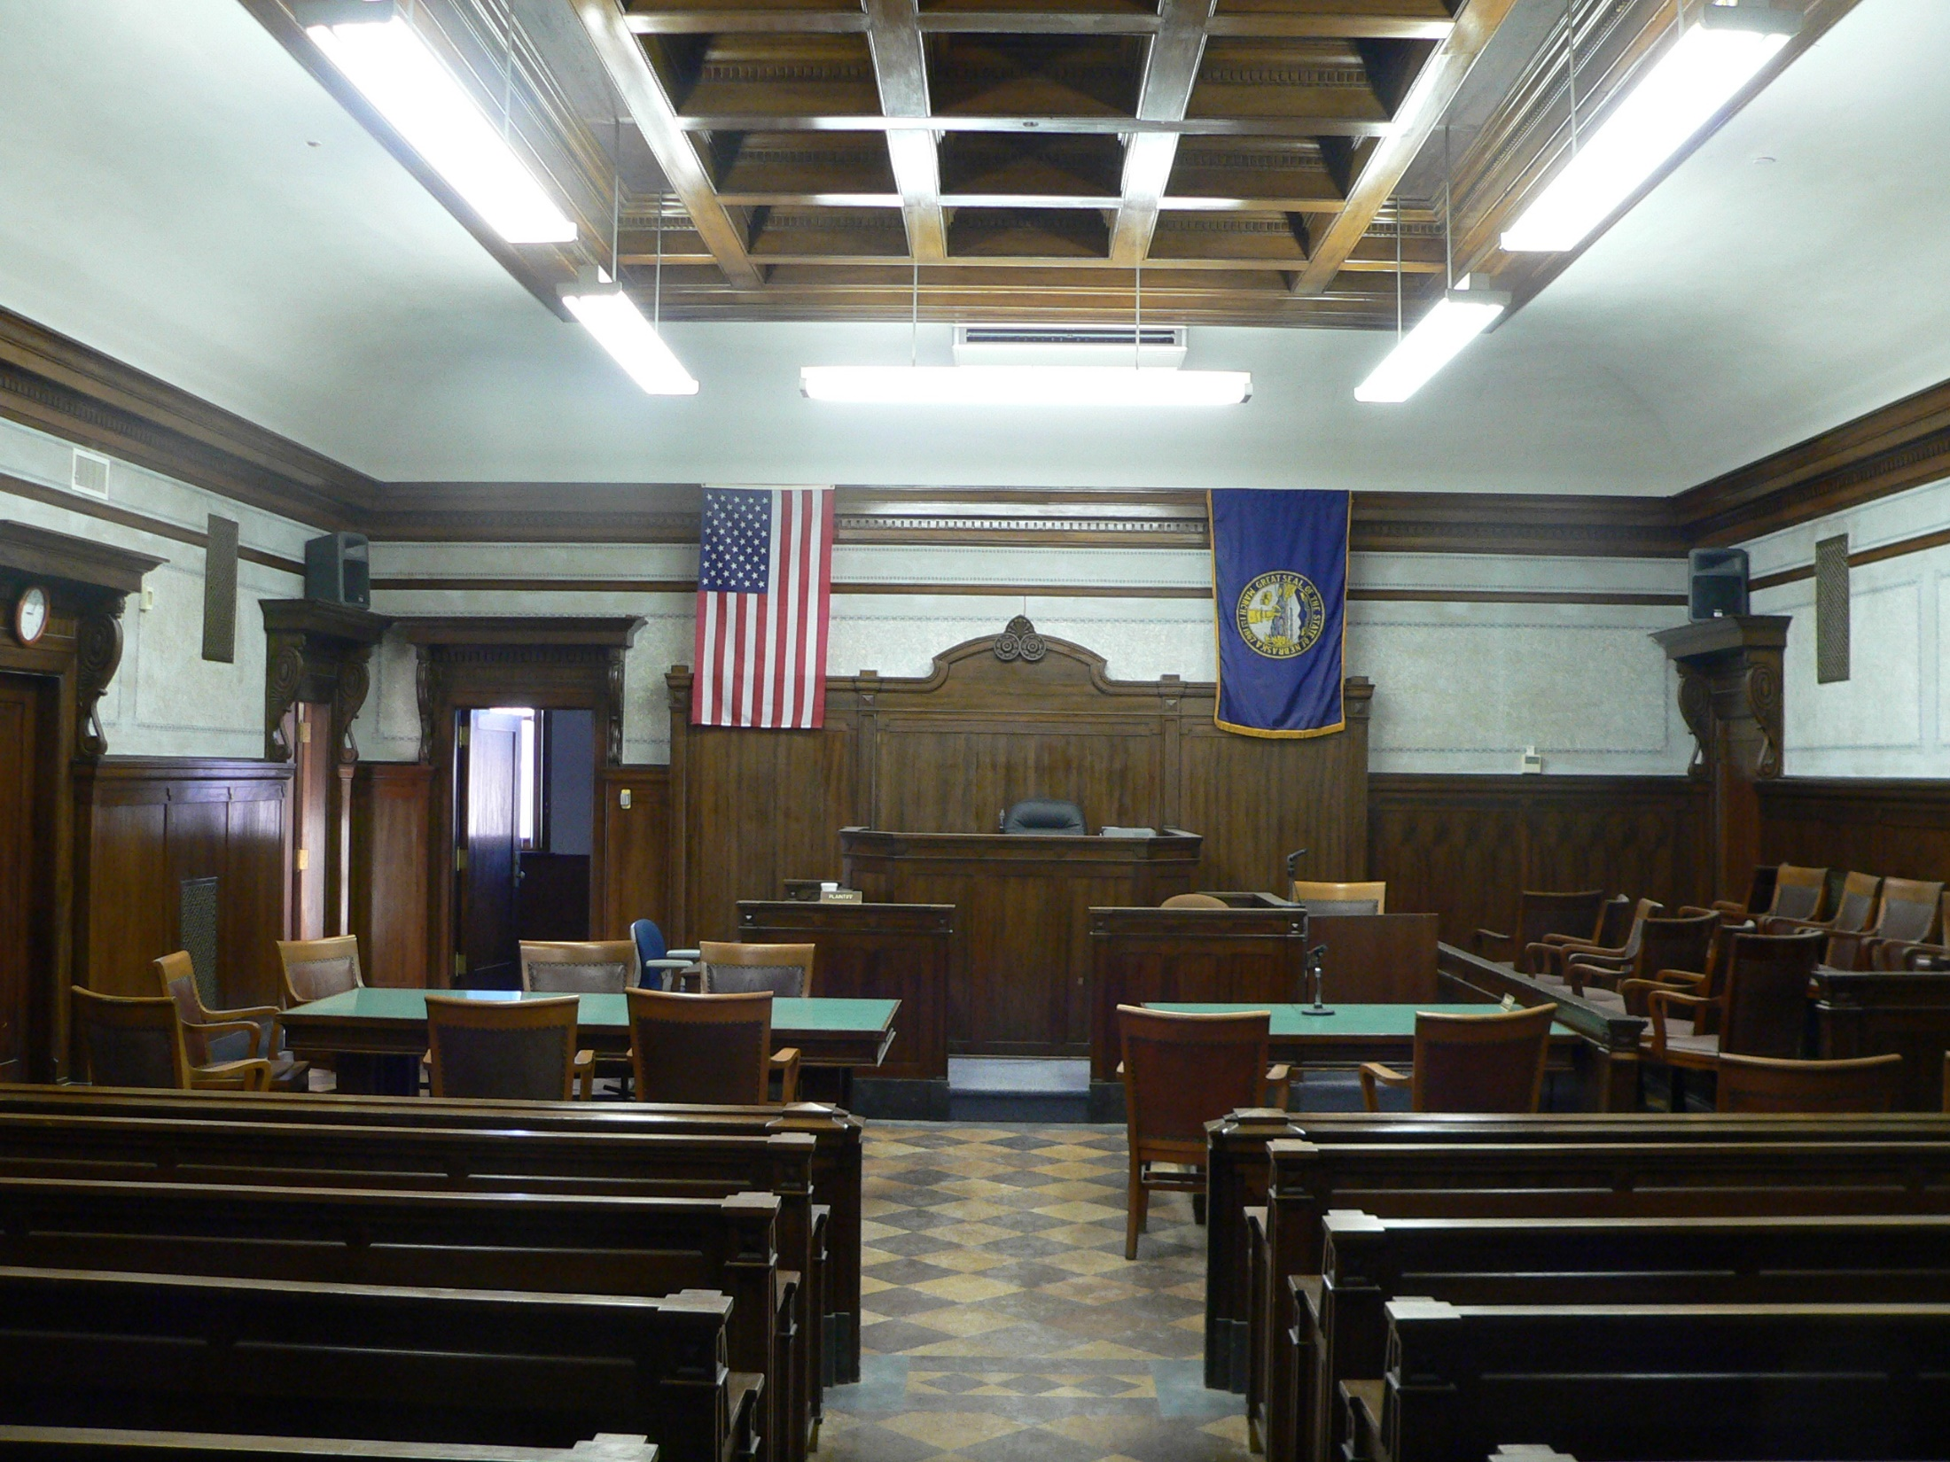
Involved Parties
Criminal
Only the Government - or State - can bring a case against someone They are the “prosecution.”
Civil
Any individual or organization that believes they have been wronged, denied civil rights, or have been damaged can bring a case, and become the “plaintiff ”

Slide 4
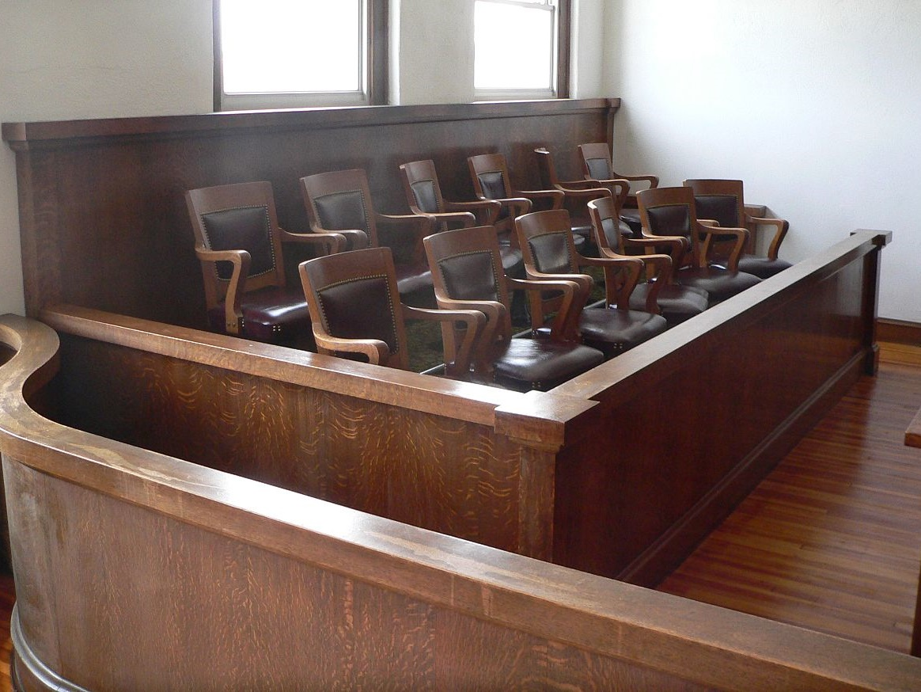
Burden of Proof
Criminal
Much Higher: “beyond a reasonable doubt” About 98% likelihood of guilt Always on the state
Civil
Lower: probably guilty More than 50% likelihood of guilt Mostly on the plaintiff

Slide 5
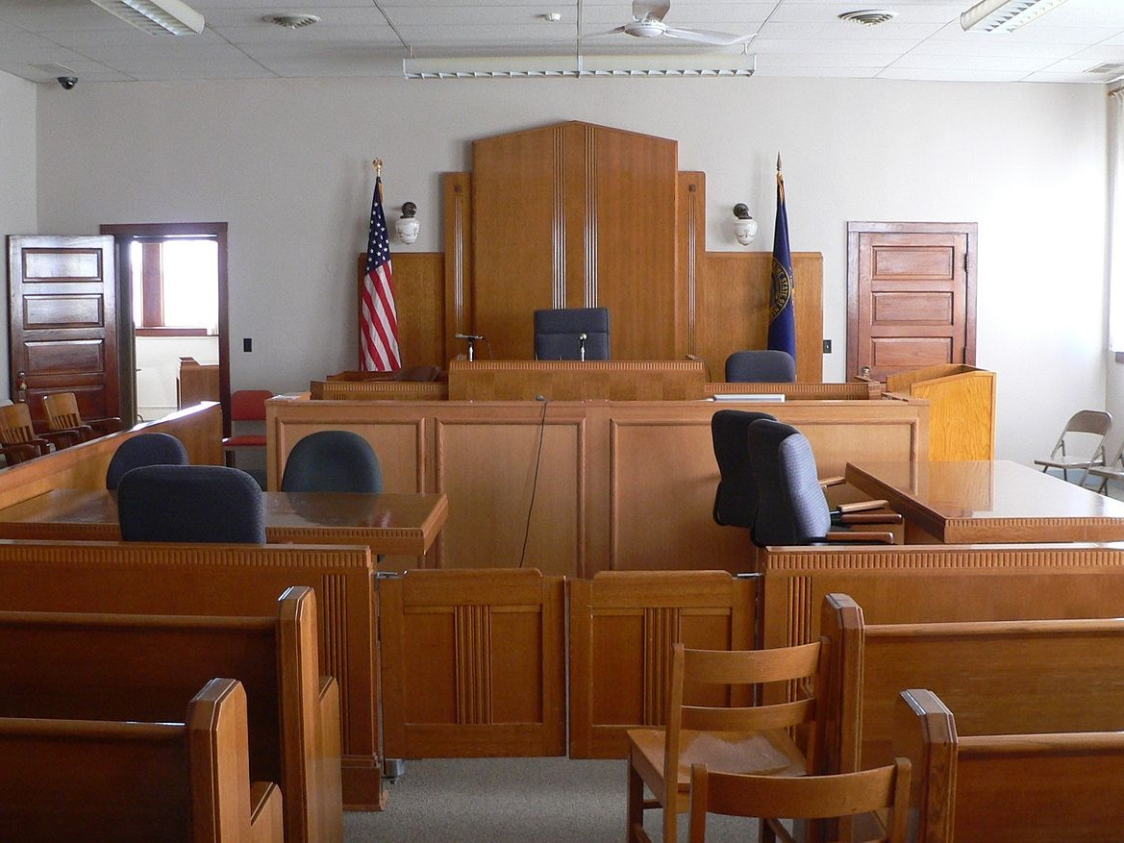
Punishment
Criminal
Includes fines, incarceration, and even execution Depends on misdemeanor, or felony
Civil
Never can result in jail time. Only fines or some sort of legal action.

Slide 6
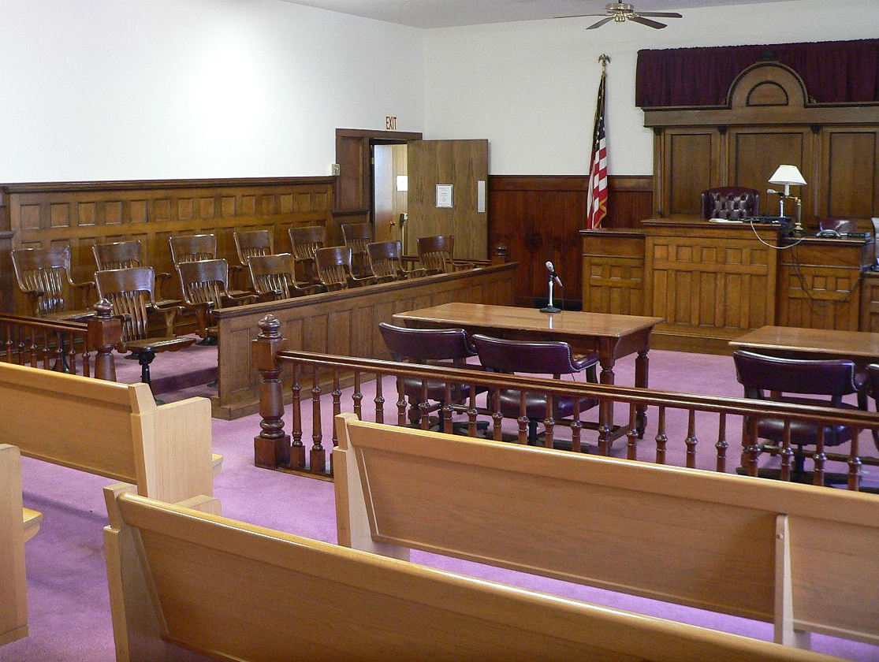
Punishments
Felony
Class 1:Life/Death Class 2: Min 4 yrs- Max 10 yrs Class 3: Min 2.5 yrs- Max 7 yrs Class 4: Min 1.5 yrs-Max 3 yrs Class 5: Min 9 months-Max 2 yrs Class 6: Min 6 months- Max 1.5 yrs
Misdemeanor
1. Class 1: 6 months. 2. Class 2: 4 months. 3. Class 3: 30 days. Fines: 1. Felonies may not exceed a fine of: $150,000 2. Class 1 misdemeanors may not exceed $2,500

Slide 7
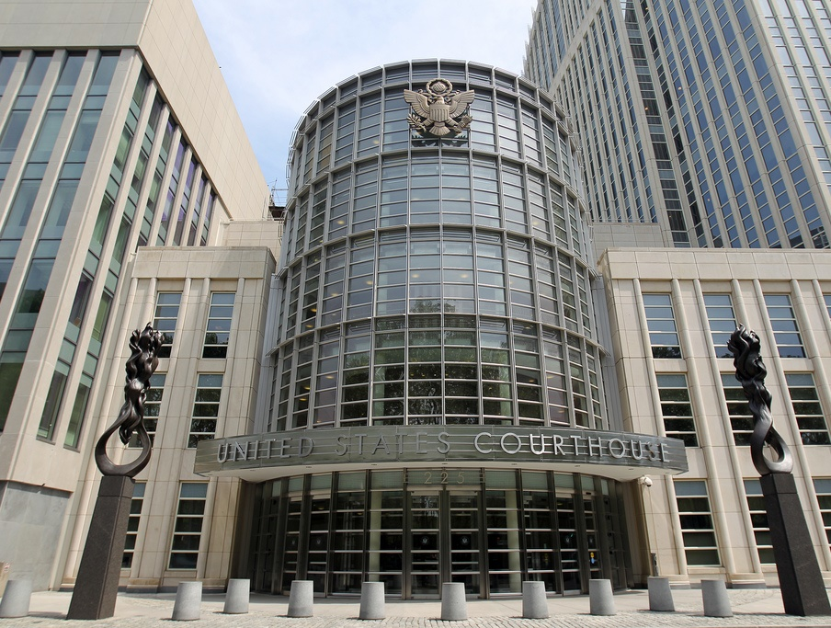
Federal Jurisdiction:
Cases that arise under a federal law (called “federal question” cases):
Ex. a civil rights organization sues a restaurant chain for a policy of discouraging minorities from eating there

Slide 8
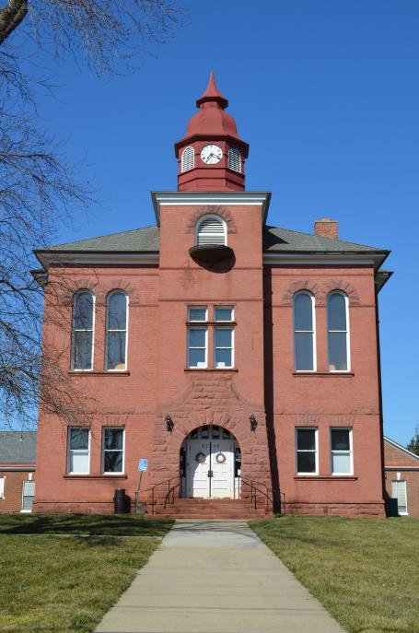
State Court Jurisdiction
Mostly deal with State laws
Hear cases involving events that took place in the state where the court sits or if defendants reside in or are served with a summons & complaint in that state.
Notes:
Picture: Fifth Prince William County Courthouse, Manassas

Slide 9
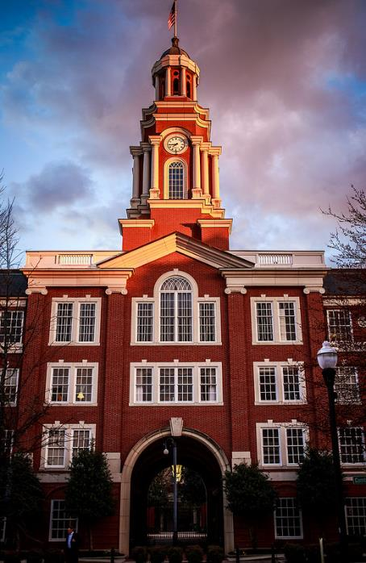
Concurrent Jurisdiction
Many state cases can go in either federal or state.
If a case can be heard in either, it is said to have concurrent jurisdiction.

Slide 10
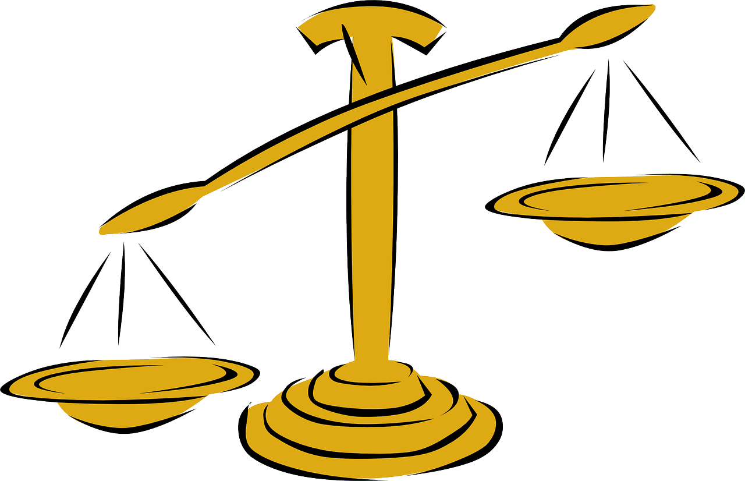
Appellate Jurisdiction
To hear a case on appeal (or for a 2nd time).
Only the defendant can appeal a case in a criminal case
The prosecution retrying a case is known as double jeopardy, and is prohibited by the constitution.

Slide 11
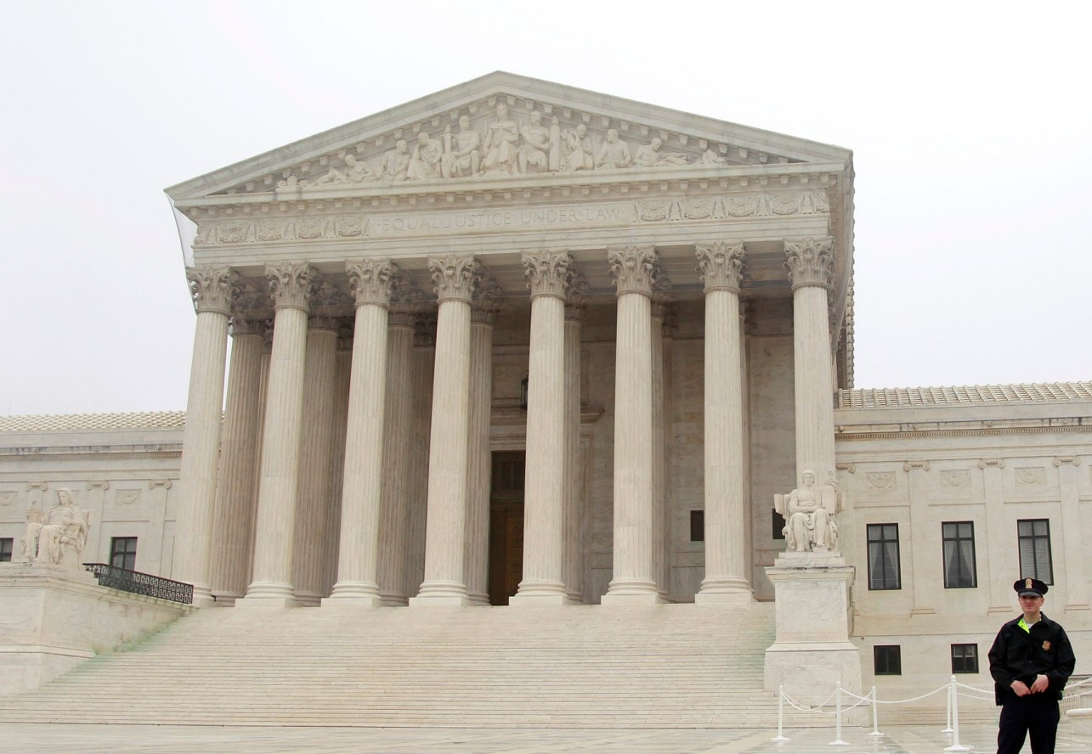
Supreme Court Original Jurisdiction
Affecting ambassadors and other public ministers and consuls
Disputes between the states
Issues that took place at sea
Controversies to which the US is a party

Slide 12
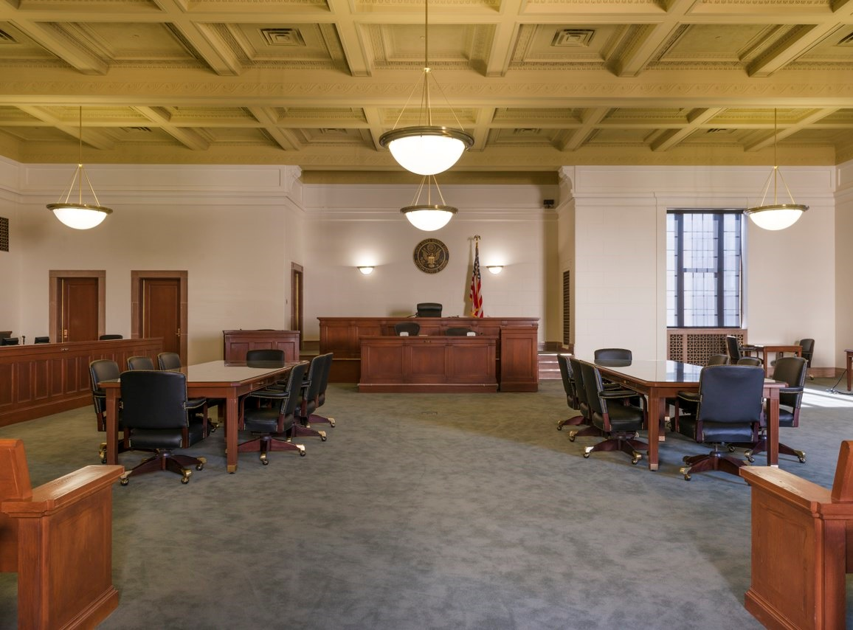
Cases That Can be Appealed
Criminal: only by the defendant.
The Government/Prosecution can never appeal a decision.
Civil cases can be appealed by either party, plaintiff or defendant

Slide 13
Reasons for Appeal
Rights have been violated during the trial.
Ex. You did not receive proper counsel
The Jury was biased
The evidence that was used against you was unconstitutionally found.
Constitutionality of the law
Discovery of new evidence

Slide 14
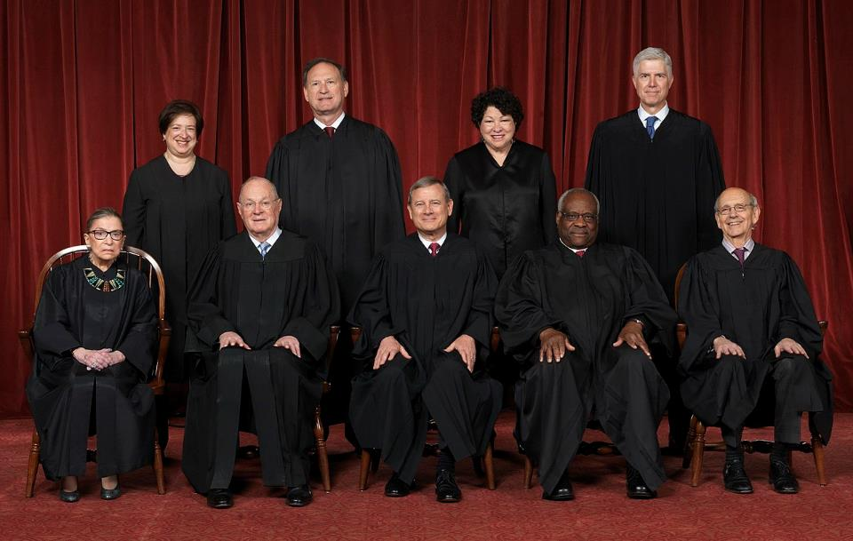
Appeals
Once the case has been heard in appellate courts, the loser can make an appeal to the Supreme Court.
The Supreme Court gets on average, over 7,000 petitions a year
Justices vote on which ones they want to hear
Only hear less than 100 cases a year.

